Slide 1
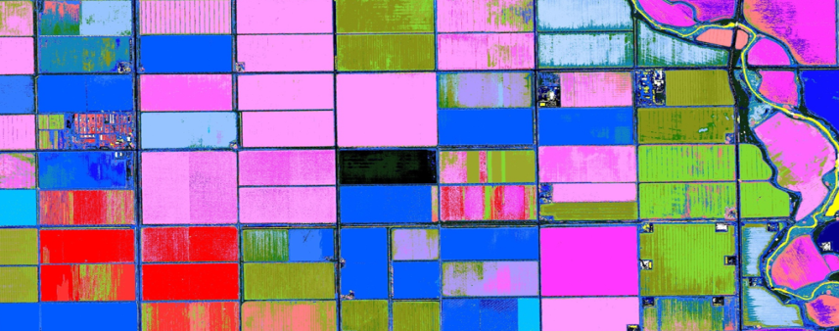
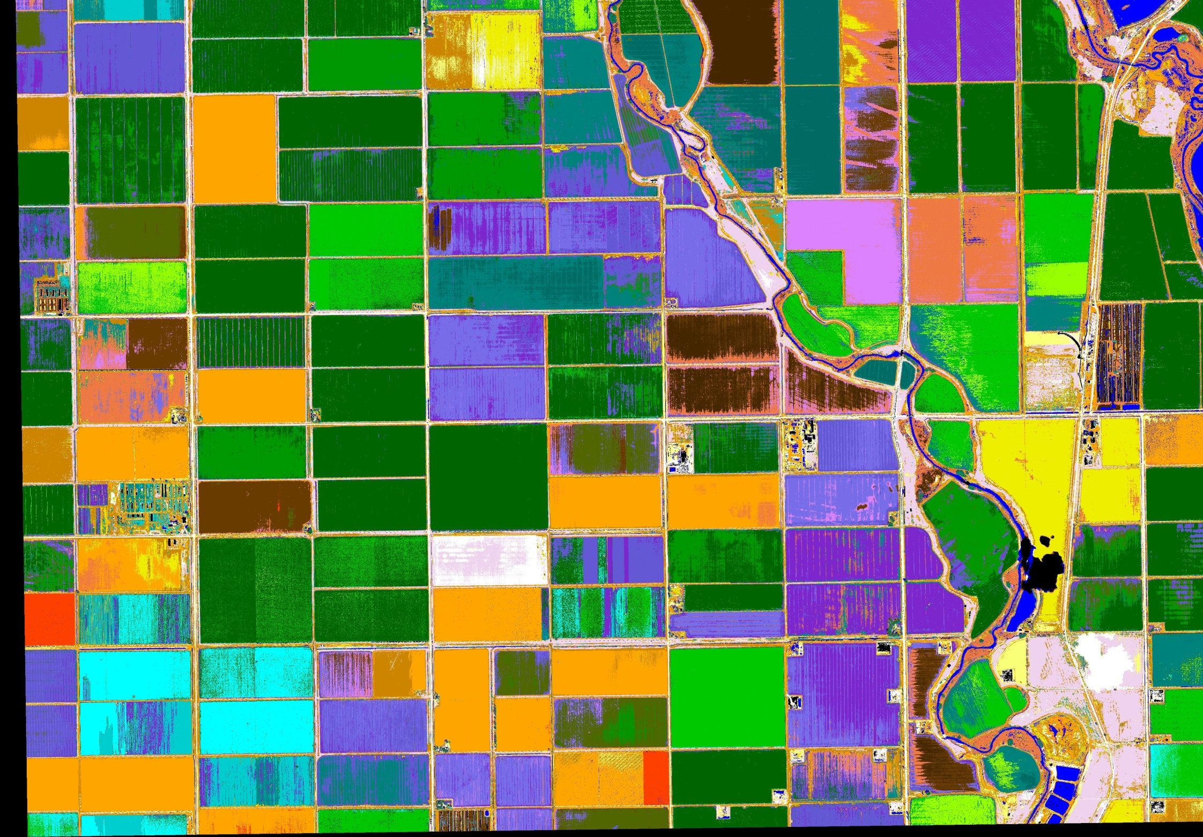
8 Band Analysis-
More Detail, Better Insight

Slide 2
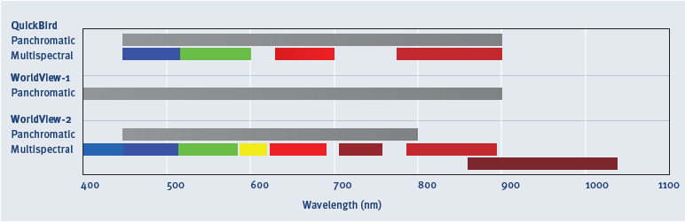
8 Bands – More Detail, Better Insight
WorldView-2 has the only commercial high resolution satellite to capture in 8 band imagery, allowing for greater feature extraction, vegetation & bathymetric analysis.
Additional bands include Coastal Blue, Red Edge, Yellow and NIR2.
Proprietary and Business Confidential
2

Slide 3
8 Bands – More Detail, Better Insight
Coastal
Coastal Applications:
Bathymetry
Yellow
Better visualization
Red Edge
Map vegetation health
Vegetation mapping
NIR2
Biomass Mapping

Slide 4
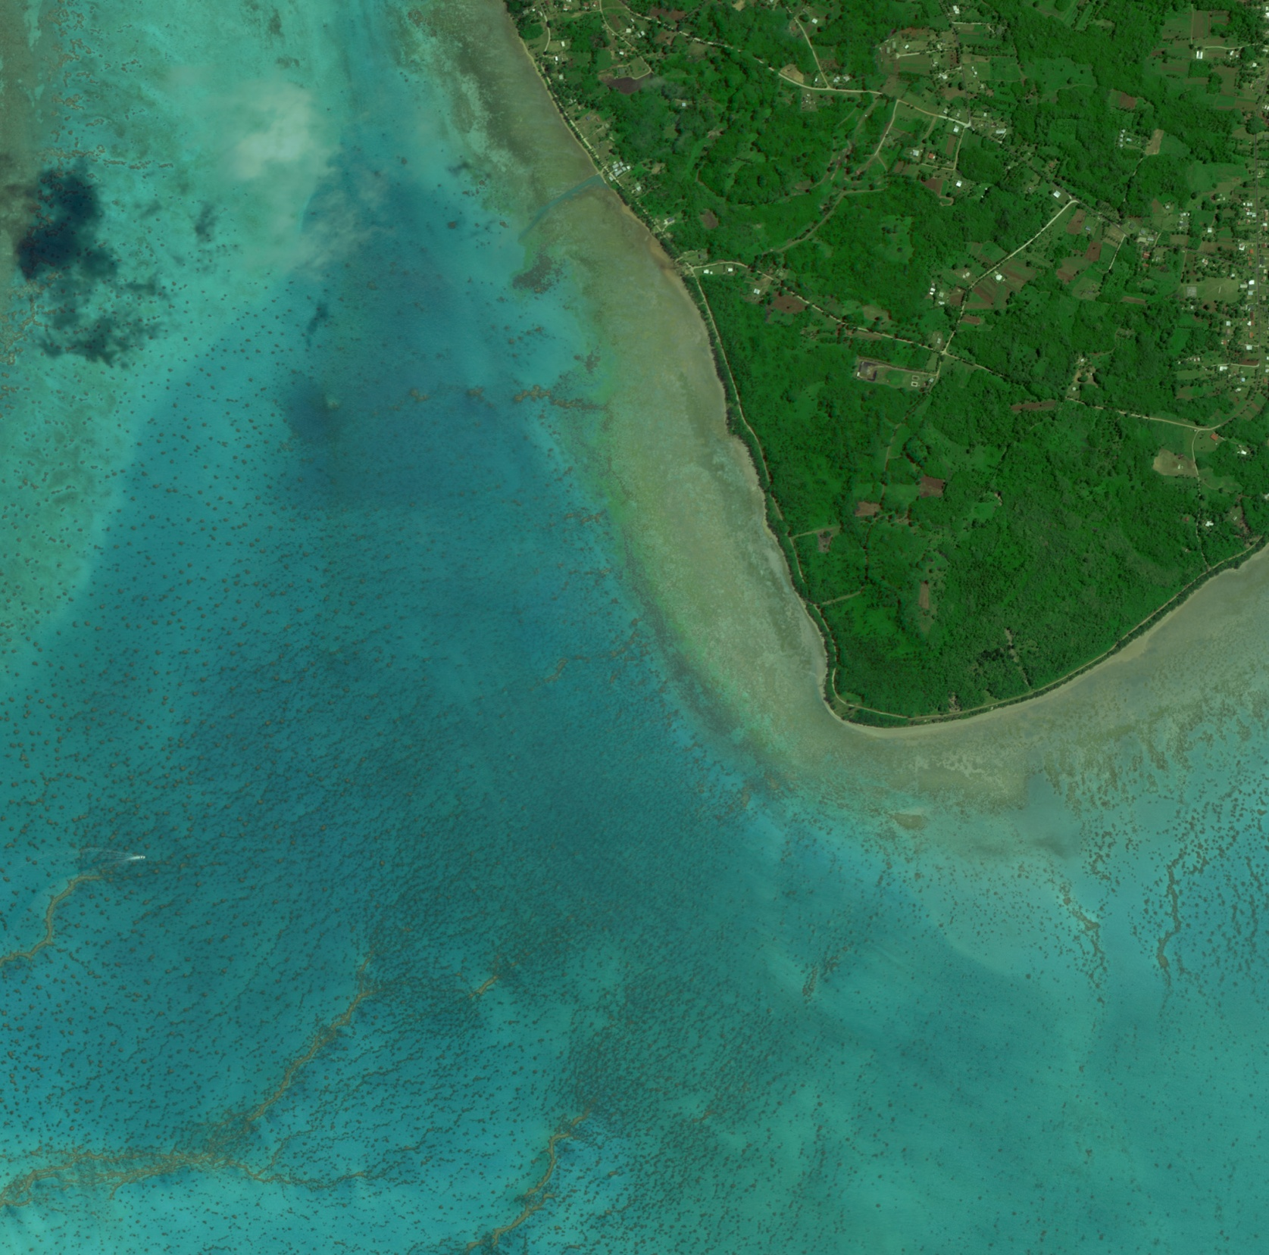
8 Bands – More Detail, Better Insight
Aitutaki Lagoon Bathymetrie
Aitutaki Lagoon
WorldView-2
4 band 2m Image
November 23, 2009

Slide 5
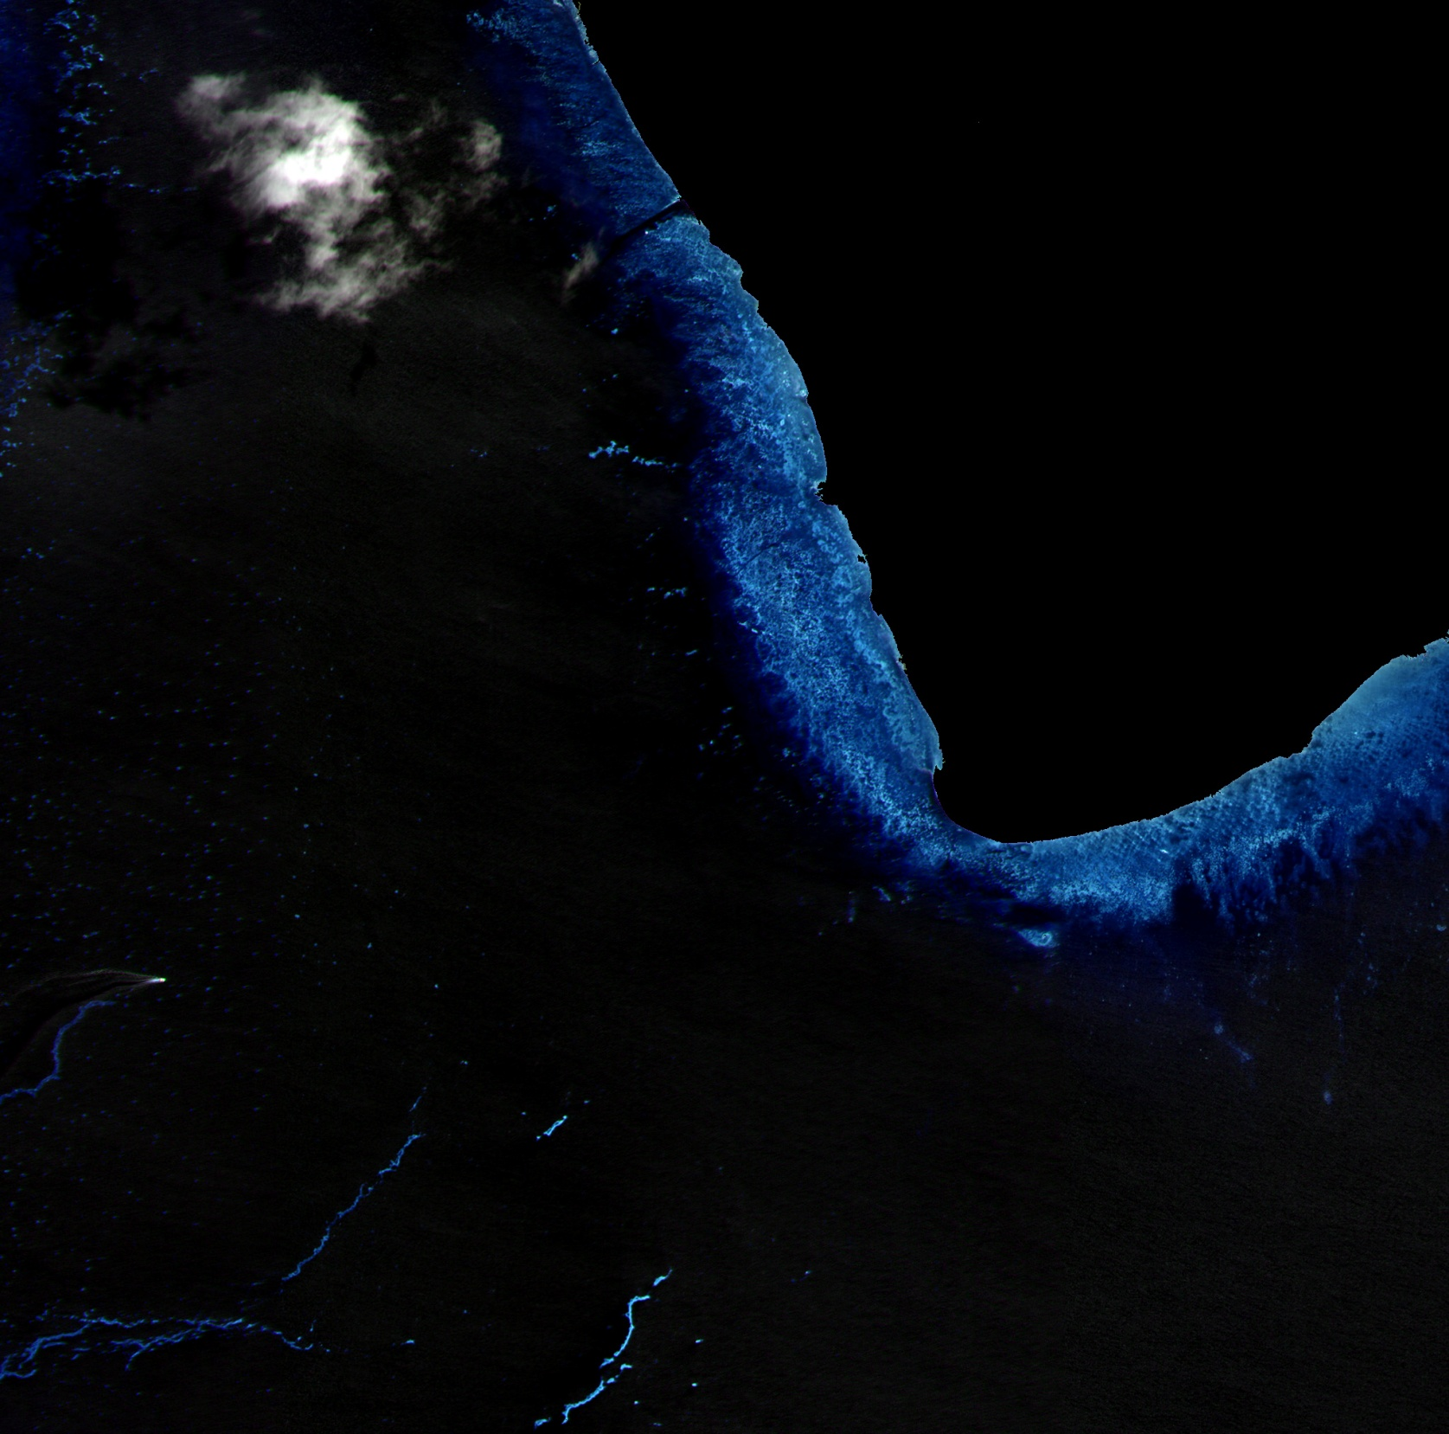
8 Bands – More Detail, Better Insight
Aitutaki Lagoon Bathymetrie
Aitutaki Lagoon
WorldView-2
RE, NIR1, NIR2
2m Image
November 23, 2009
wave refraction patterns and submerged aquatic vegetation
linear reefs

Slide 6
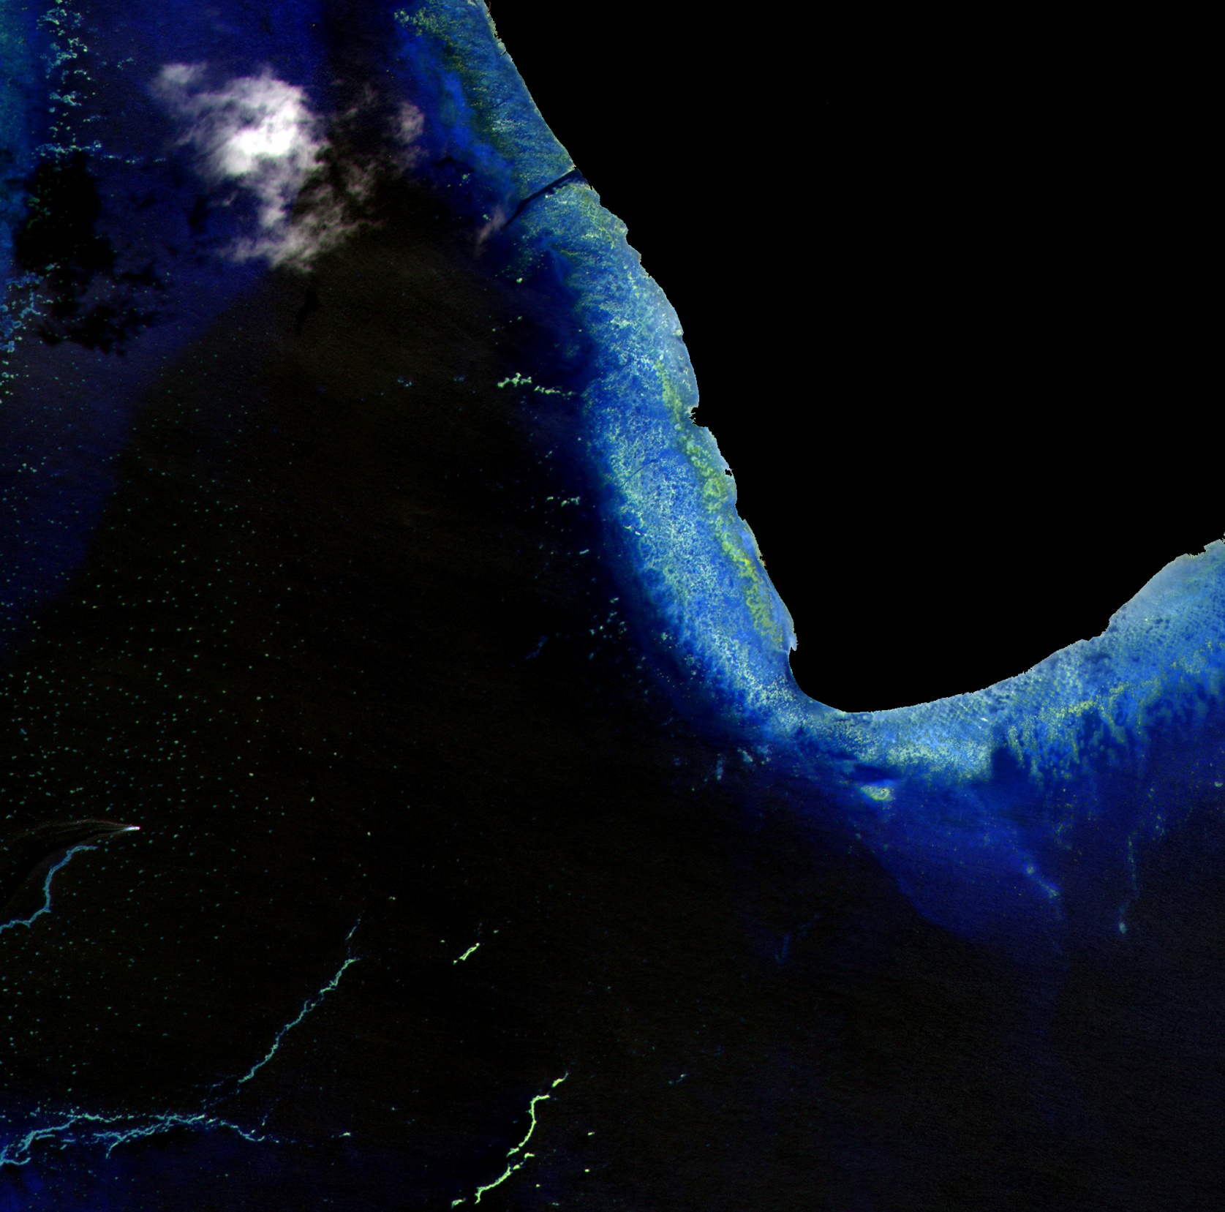
Aitutaki Lagoon Bathymetrie
Aitutaki Lagoon
WorldView-2
R, RE, NIR1
2m Image
November 23, 2009
submerged aquatic vegetation

Slide 7
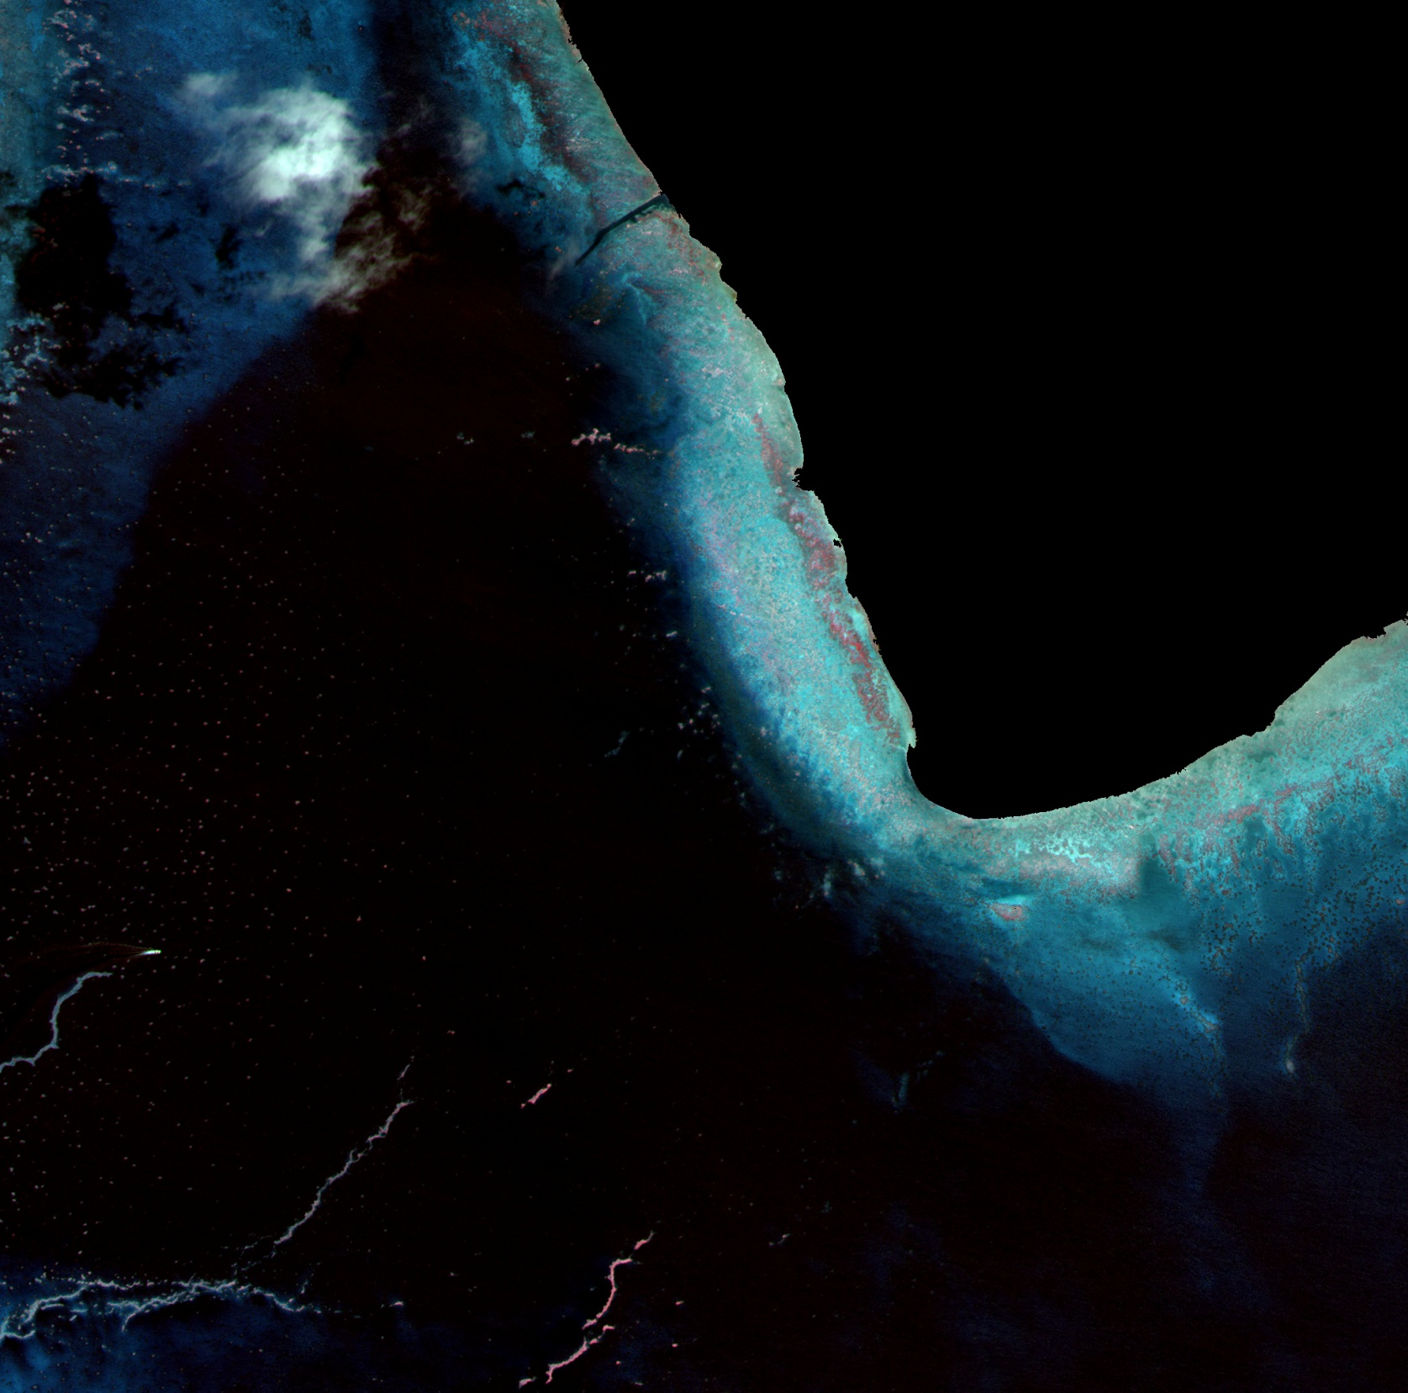
8 Bands – More Detail, Better Insight
Aitutaki Lagoon Bathymetrie
Aitutaki Lagoon
WorldView-2
Y, R, RE
2m Image
November 23, 2009
submerged aquatic vegetation
submerged aquatic vegetation

Slide 8
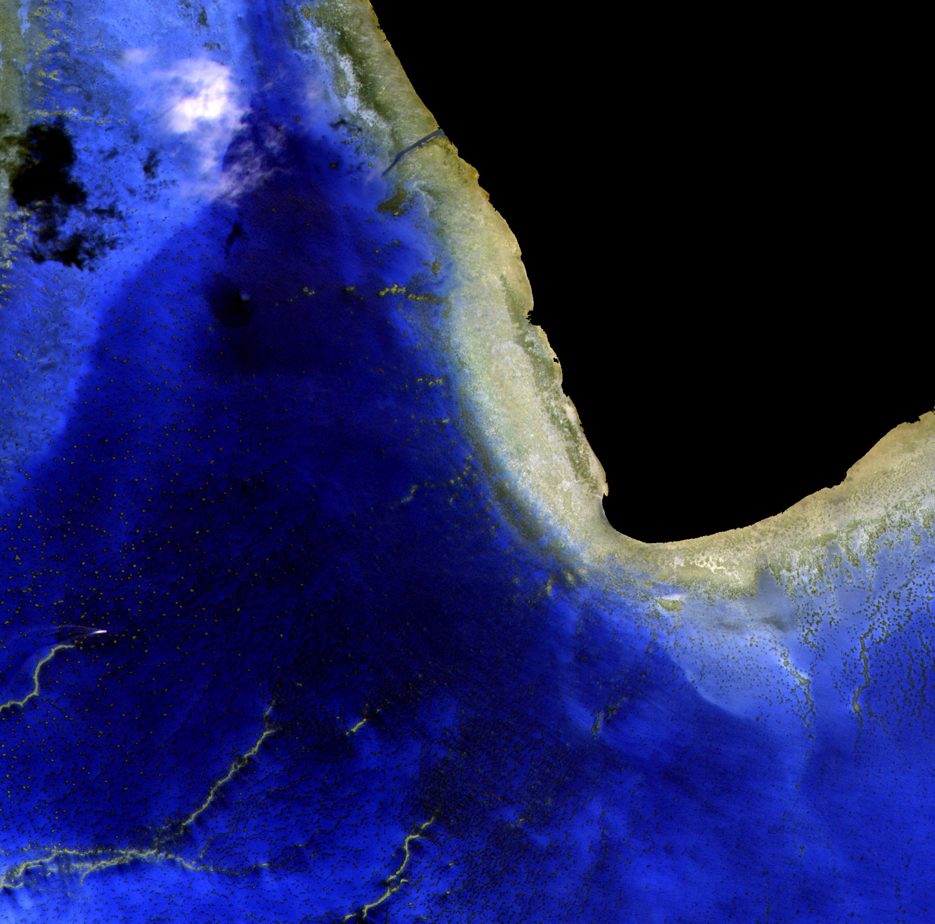
8 Bands – More Detail, Better Insight
Aitutaki Lagoon Bathymetrie
Aitutaki Lagoon
WorldView-2
G, Y, R
2m Image
November 23, 2009

Slide 9
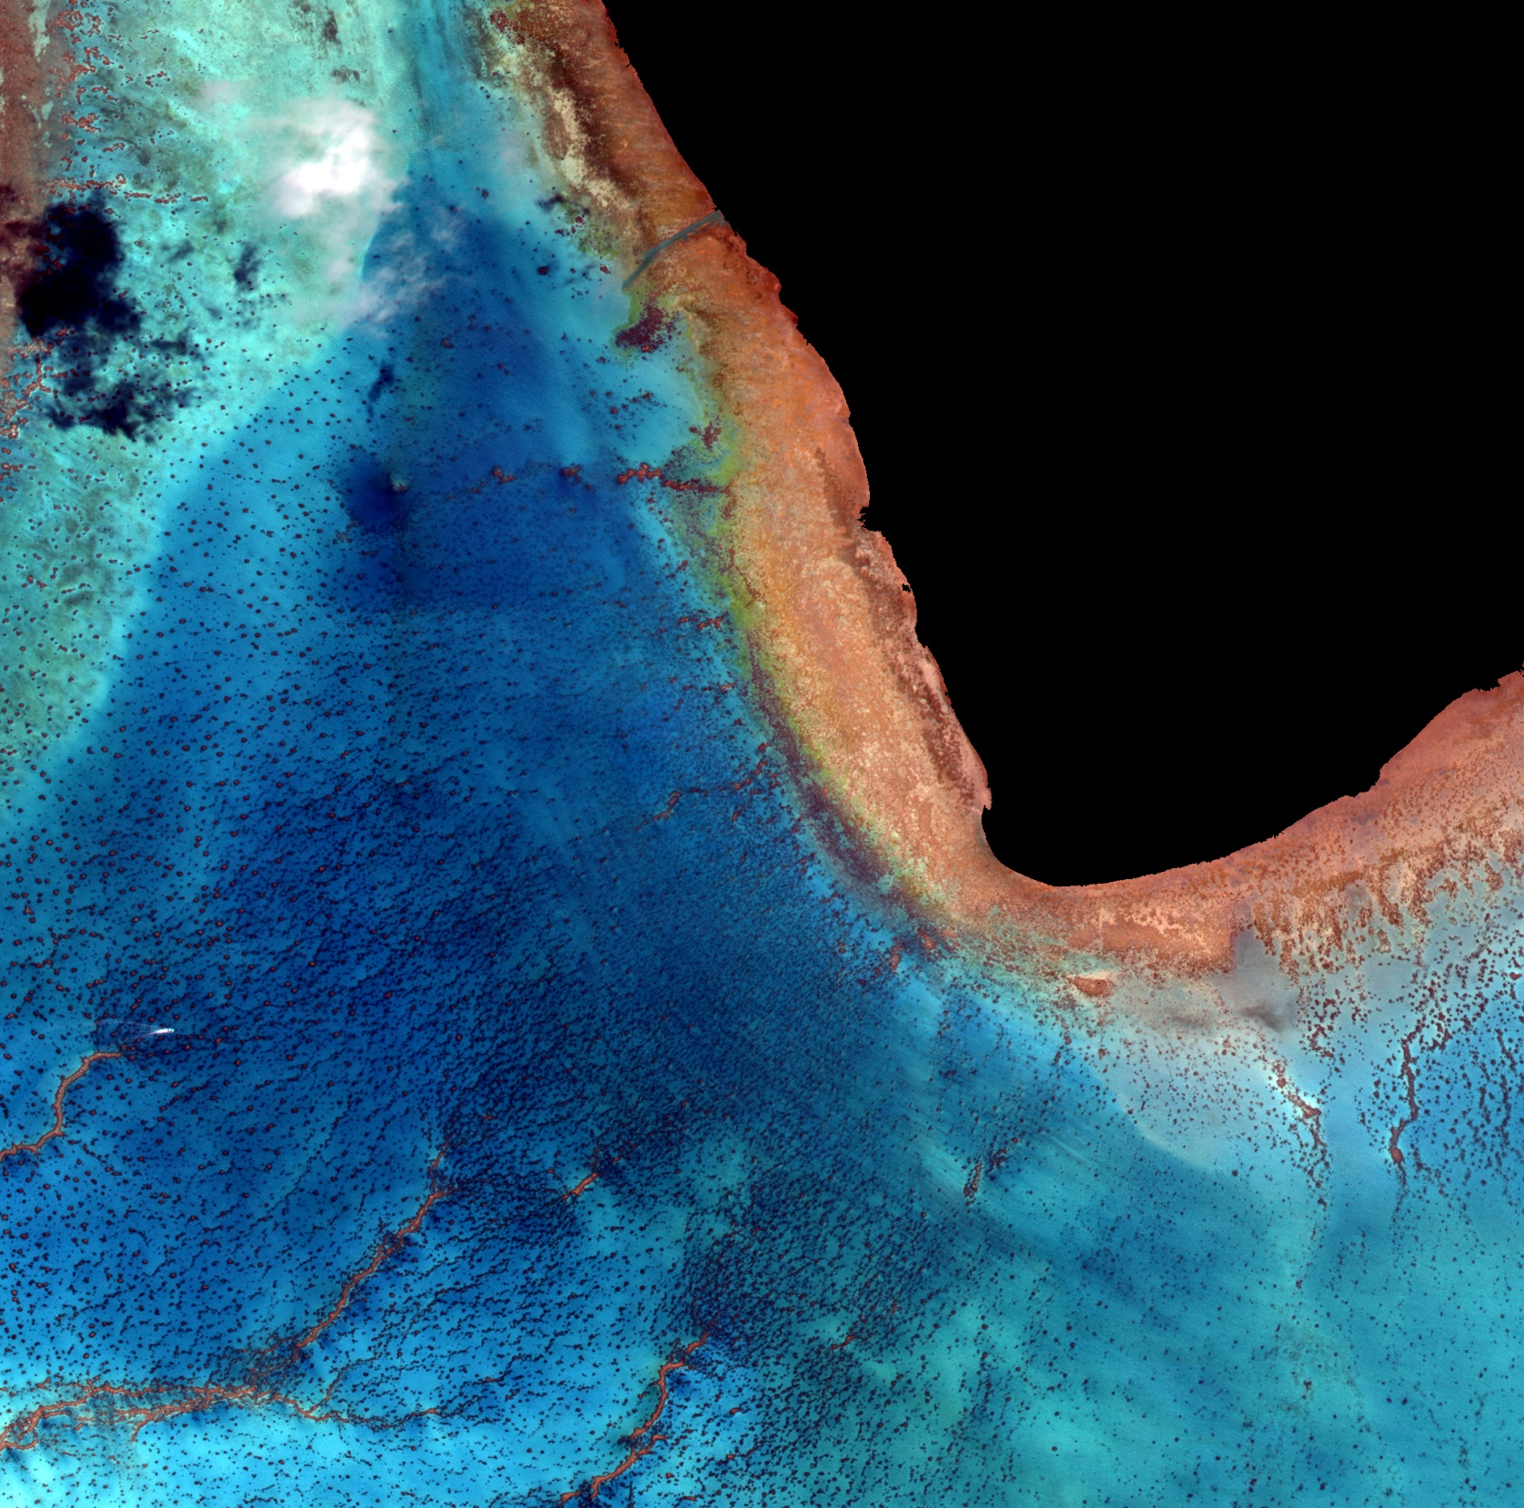
8 Bands – More Detail, Better Insight
Aitutaki Lagoon Bathymetrie
Aitutaki Lagoon
WorldView-2
B, G, Y
2m Image
November 23, 2009

Slide 10
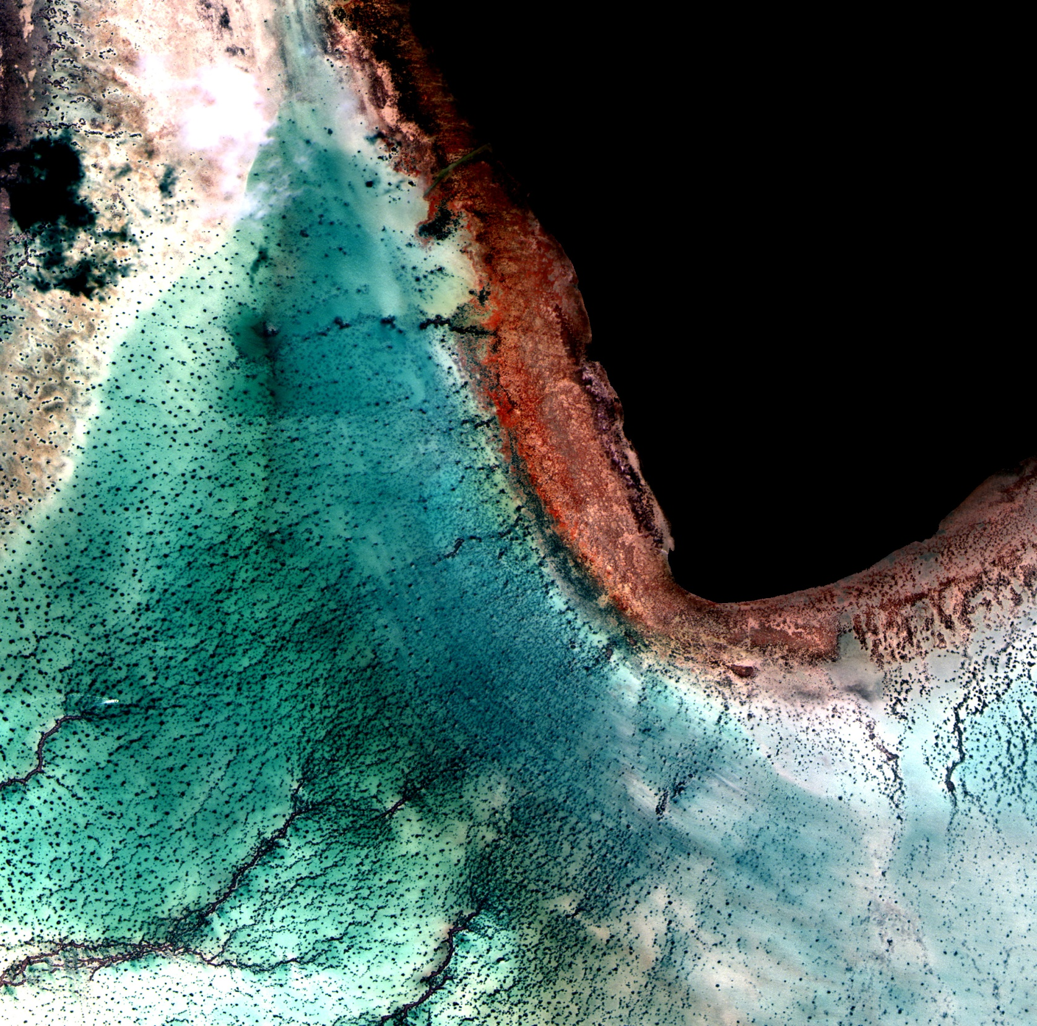
8 Bands – More Detail, Better Insight
Aitutaki Lagoon Bathymetrie
Aitutaki Lagoon
WorldView-2
C, B, G,
2m Image
November 23, 2009

Slide 11
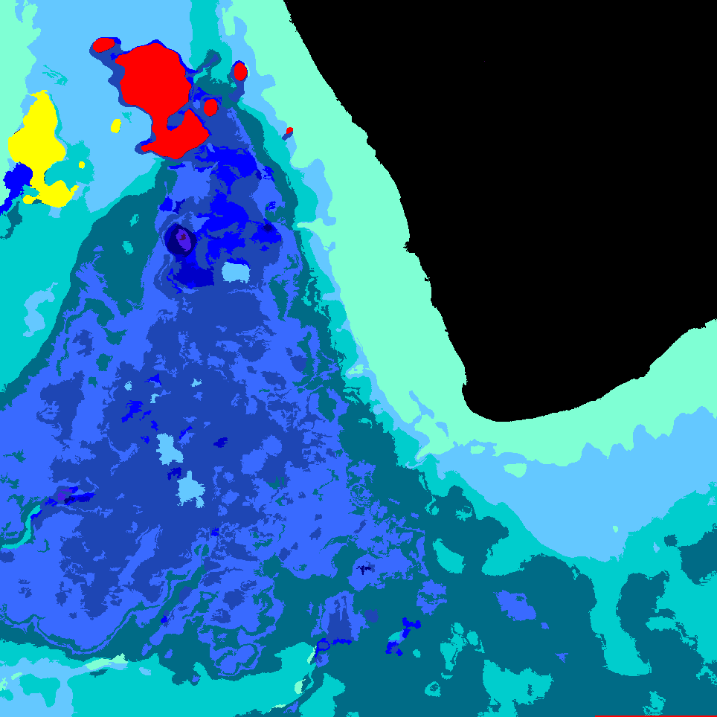
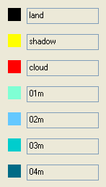
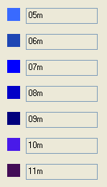
8 Bands – More Detail, Better Insight
Aitutaki Lagoon Bathymetrie
Aitutaki Lagoon Bathymetrie Legend

Slide 12
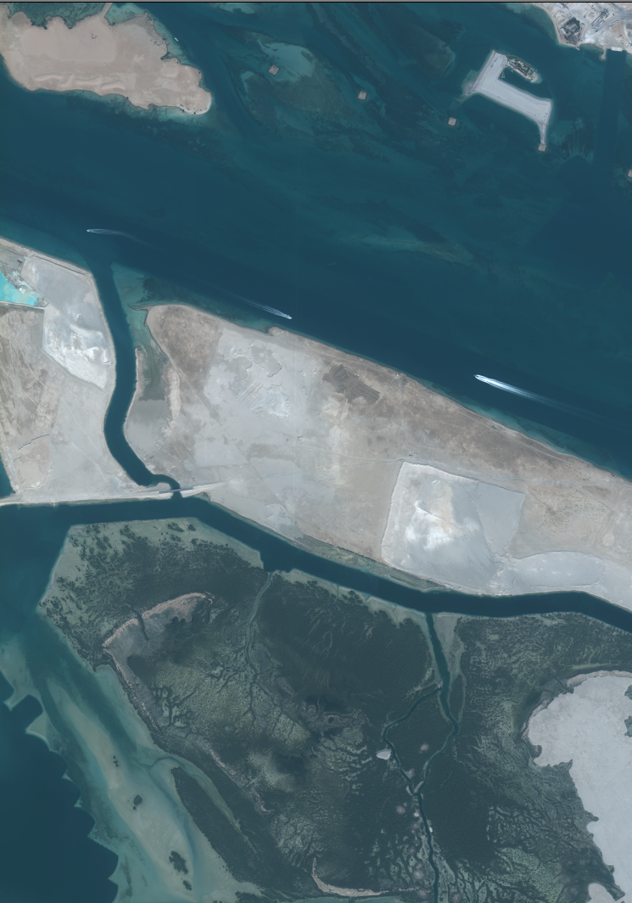
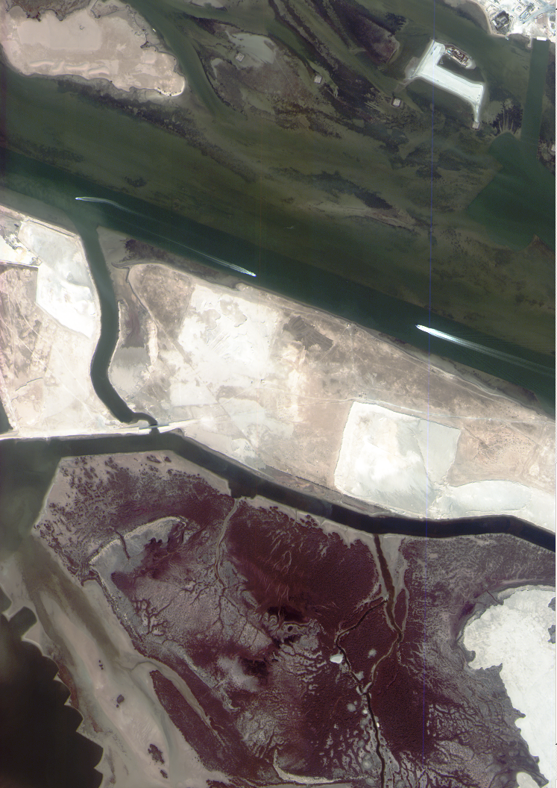
Use of the 8 Bands:
Port Navigation
Better water penetration aids in dredging operations for port navigation
RBG
Green, Blue, Coastal

Slide 13
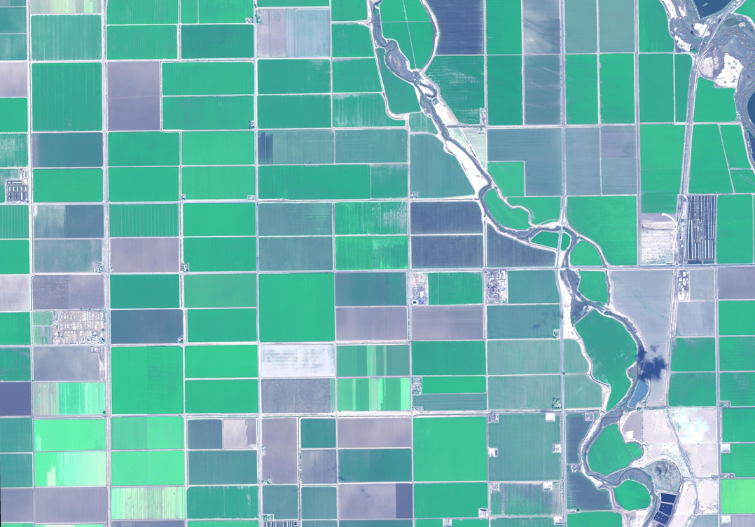
8 Bands – More Detail, Better Insight
Agriculture: Crop Identification
WorldView-2
True Color Image,
1m Image
Salton Sea
Feb 20, 2010
Notes:
From Principal Component analysis – to help understand anomalies and variables – it is possible to use the bands to identify types of crop – crop stress and state of soils.
Salton Sea California. Licit crops.

Slide 14
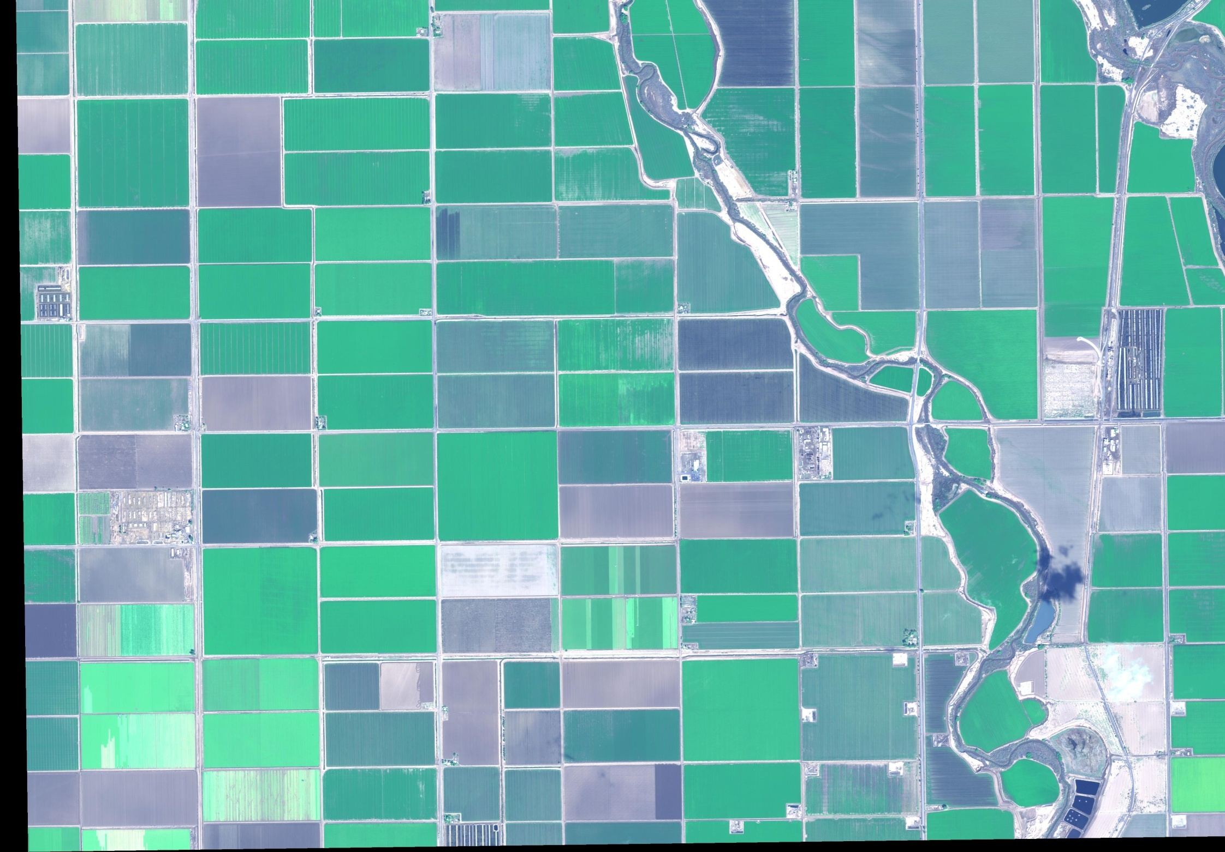
WorldView-2
true color image
Salton Sea
Feb 20, 2010

Slide 15
water
freshly tilled
WorldView-2
land covers
Salton Sea
Feb 20, 2010

Slide 16
moist soil
WorldView-2
land covers
Salton Sea
Feb 20, 2010

Slide 17
partially harvested
WorldView-2
land covers
Salton Sea
Feb 20, 2010

Slide 18
stressed vs mature crop
WorldView-2
land covers
Salton Sea
Feb 20, 2010

Slide 19
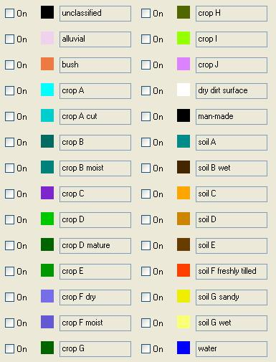

Slide 20
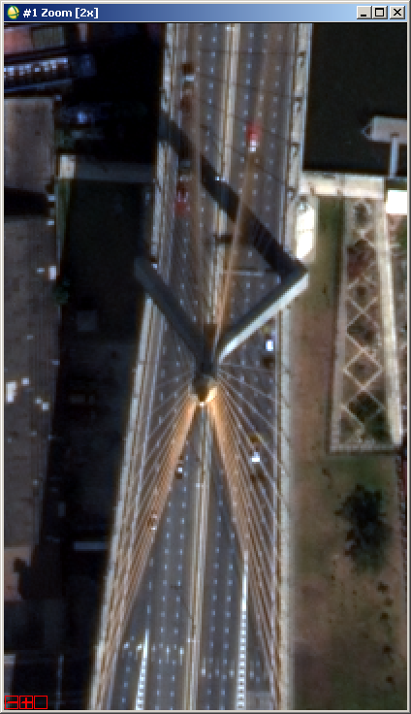
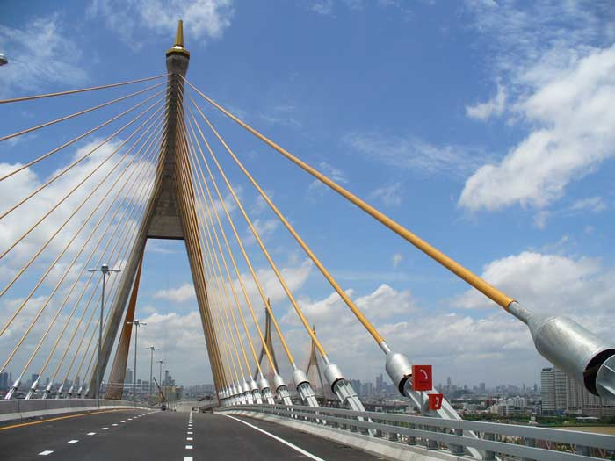
8 Bands – More Detail, Better Insight
Yellow Band: Bangkok Mega Bridge

